Slide 1

BUSINESS ANALYTICS CLUB
Workshop Series 10.24
VBA-pardy
Janet Ye

Slide 2
VBA-pardy
100
200
300
400
500

Slide 3
Rules
The teams will be made up of Left and Right halves of the room. Think of a team name!
Objective is to score as many points as possible.
The problem / point value will be projected.
First team to post a correct answer to the problem on the BAC facebook wall wins: www.facebook.com/SternBAC (specify your team name)
Team with the winning points will receive a mysterious prize

Slide 4
For 100 Points
Write your own functions swag:
Take in 2 integers
Find their average
Take that result and modulo by the second integer
Return final result
Name this function swag
Hint: a modulo b is the reminder after a/b (i.e. 5 modulo 3 is 2), performed in Excel via a Mod b

Slide 6
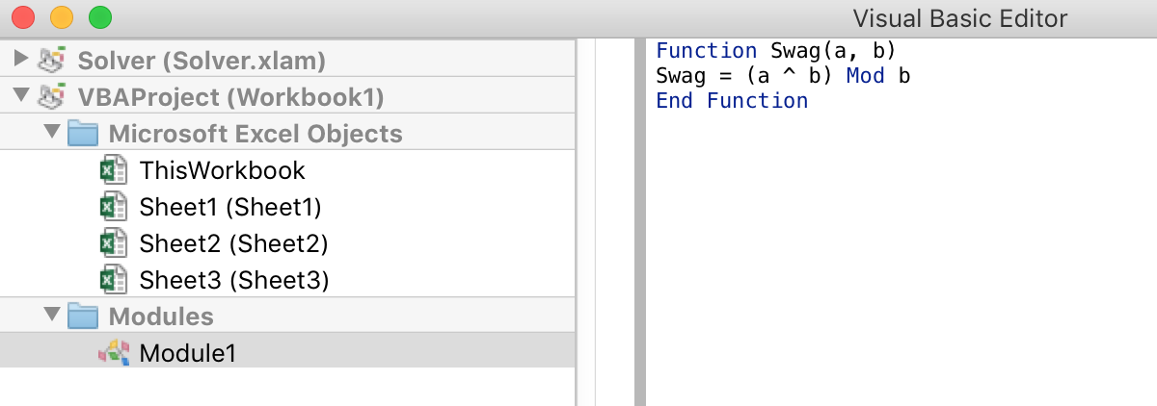
Solution: 100 Points
Function Swag(a,b)
Swag = (a^b) Mod b
End Function

Slide 7
VBA-pardy
🤗
200
300
400
500

Slide 8
For 200 Points
Write your own functions datecheck:
Take a date (ex: 1/1/2013) and an integer representing day of week
Check if the date matches up with the integer
weekday function should return TRUE if date matches up with the integer, FALSE otherwise
Hint: Weekday(“10/24/2015”) returns 7, representing Saturday
Sun = 1, Mon = 2, …, Sat = 7

Slide 10
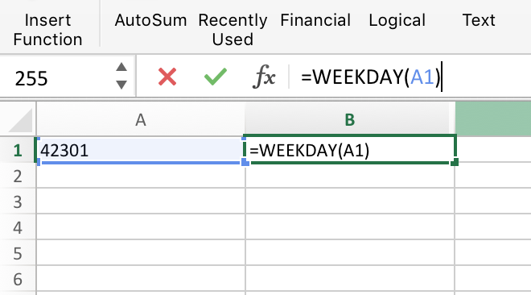
Solution: 200 Points
Function datecheck(d, n)
dayofweek = Weekday(d, 1)
datecheck = (n = dayofweek)
End Function
10/24/2015

Slide 11
VBA-pardy
🤗
🤖
300
400
500

Slide 12
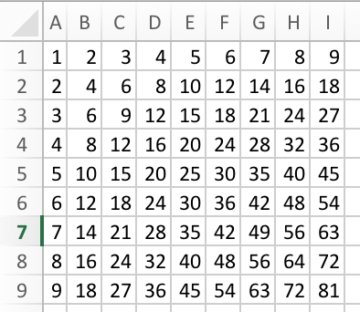
For 300 Points
Write your own subroutine multtable:
The subroutine should generate a multiplication table like the following
For instance, cell(3,4) should give the value 12, cell(5,7) gives 35, etc.
Hint: consider using a loop within a loop

Slide 14
Solution: 300 Points
Sub multtable()
For Row = 1 To 9
For Col = 1 To 9
Cells(Row, Col) = Row * Col
Next Col
Next Row
End Sub

Slide 15
VBA-pardy
🤗
🤖
👑
400
500

Slide 16
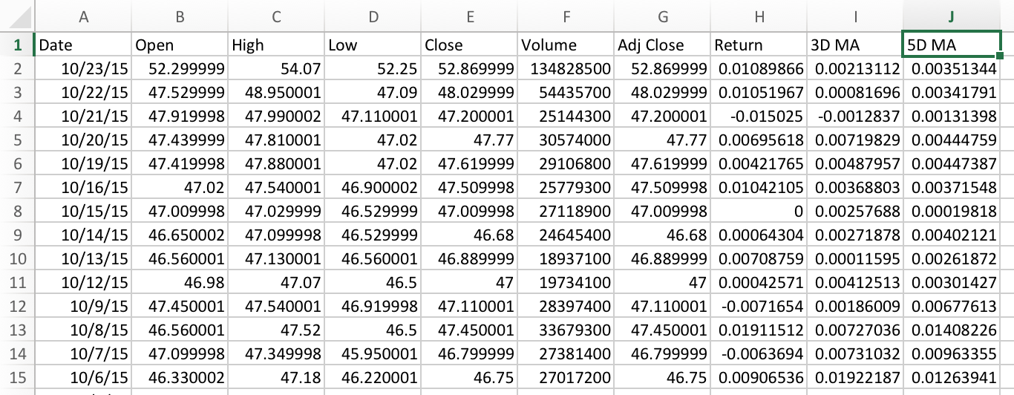
For 400 Points
Modify buysellsignal:
Fill Column J with 5-day moving average

Slide 18
Solution: 400 Points
Cells(1, 10) = "5D MA"
five_day_ma_col = 10
If (Cells(Row + 1, return_col) <> "") And (Cells(Row + 2, return_col) <> "") And (Cells(Row + 3, return_col) <> "") And (Cells(Row + 4, return_col) <> "") Then
Cells(Row, five_day_ma_col) = (Cells(Row, return_col) + Cells(Row + 1, return_col) + Cells(Row + 2, return_col) + Cells(Row + 3, return_col) + Cells(Row + 4, return_col)) / 5
End If

Slide 19
VBA-pardy
🤗
🤖
👑
🎃
500

Slide 20
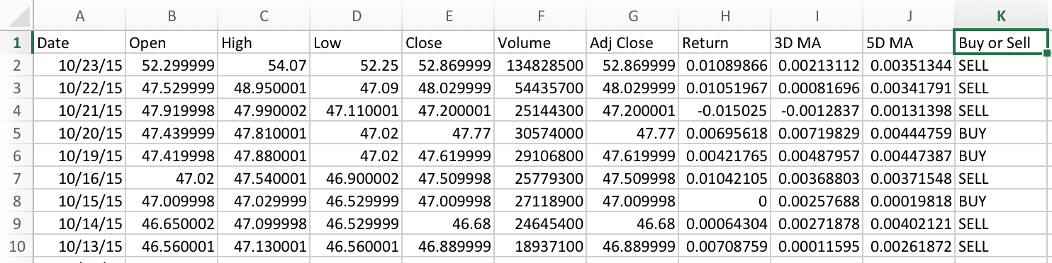
For 500 Points
Modify buysellsignal:
Fill Column K with Buy/Sell Signal
If 3D > 5D, we should BUY
If 5D > 3D, we should SELL

Slide 22
Solution: 500 Points
Cells(1, 11) = "Buy or Sell"
buy_sell_col = 11
If (Cells(Row, three_day_ma_col) <> "") And (Cells(Row, five_day_ma_col) <> "") Then
If Cells(Row, three_day_ma_col) > Cells(Row, five_day_ma_col) Then
Cells(Row, buy_sell_col) = "BUY"
End If
If Cells(Row, three_day_ma_col) < Cells(Row, five_day_ma_col) Then
Cells(Row, buy_sell_col) = "SELL"
End If
End If

Slide 23
VBA-pardy
🤗
🤖
👑
🎃
🙃

Slide 24
The mysterious prize…

Slide 25

🦄

Slide 26

🦄

Slide 27
🦄

Slide 28
🦄

Slide 29
🦄

